Slide 1

DSCI 631 Final Project Presentation (Group 22): Loan Repayment Prediction Analysis
Team Members:-
Rohit Annasaheb Ragde
Disha Yadav

Slide 2
Workload Distribution
Team Members:-
A) Rohit Annasaheb Ragde: Handled initial data exploration, EDA, and preprocessing. Also contributed to documentation related to these sections.
B) Disha Yadav: Implemented machine learning algorithms, including model evaluation and tuning. Contributed to documentation on model results and analysis.

Slide 3

1. Problem Statement
In the domain of financial lending, accurately predicting loan repayment is a critical task for financial institutions. This project aims to develop a loan repayment system that utilizes machine learning algorithms to predict the risk of loan default and manage repayment processes effectively.
Evaluate and compare various machine learning models to identify the most reliable approach for predicting loan repayment, thereby aiding in risk management and financial planning

Slide 4
2. Dataset Overview
The dataset chosen for this project provides information relevant to loan repayment prediction.
It includes various features associated with loan applications, such as applicant characteristics, financial details, credit history, and property information. Sourced from a loan lender website, the dataset comprises 614 entries, each representing a loan application
The dataset has 614 rows and 13 columns

Slide 5
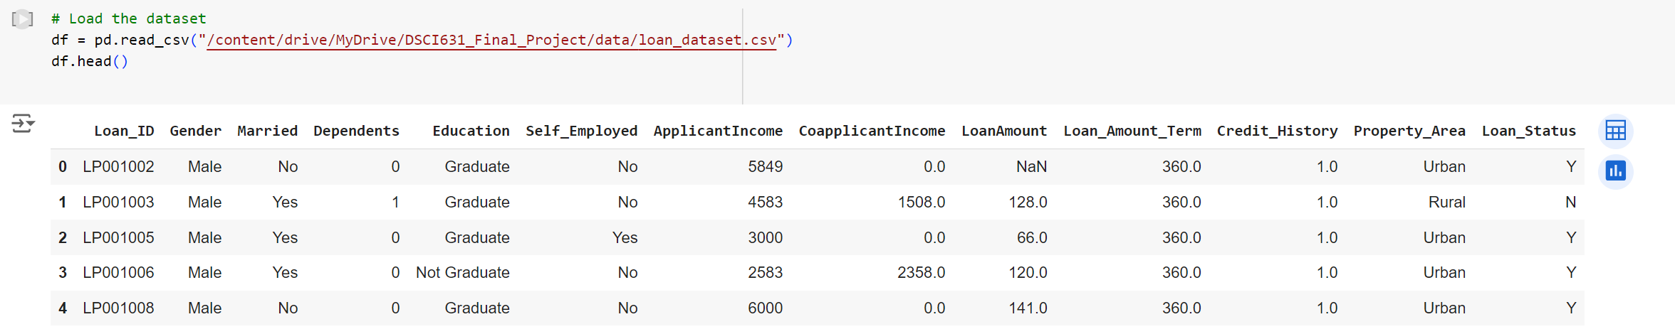
2. Dataset Overview
The dataset consists of 614 loan applications, including features such as applicant demographics (Gender, Married, Dependents, Education), financial details (ApplicantIncome, CoapplicantIncome, LoanAmount), credit history, and loan status. Key features include Loan_ID, ApplicantIncome, LoanAmount, and Credit_History

Slide 6
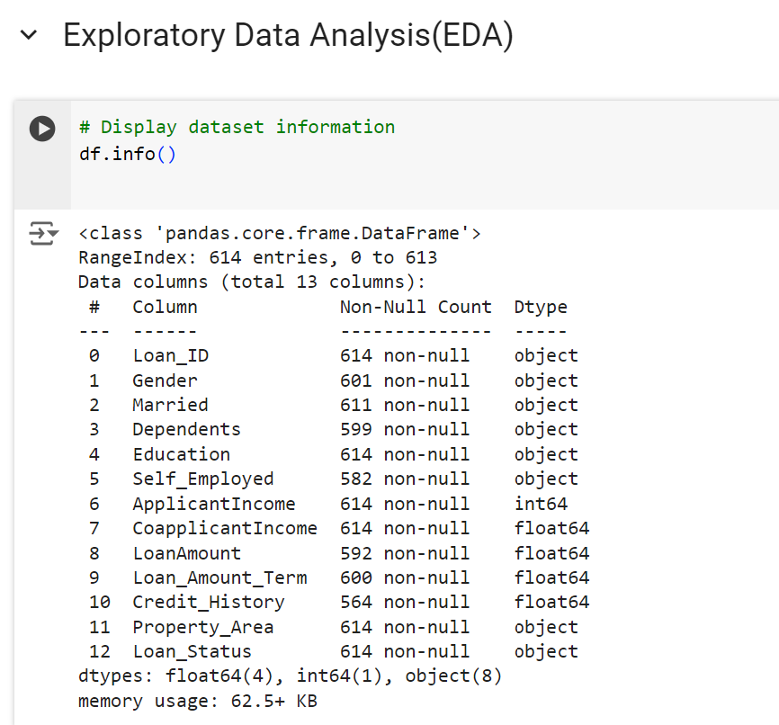
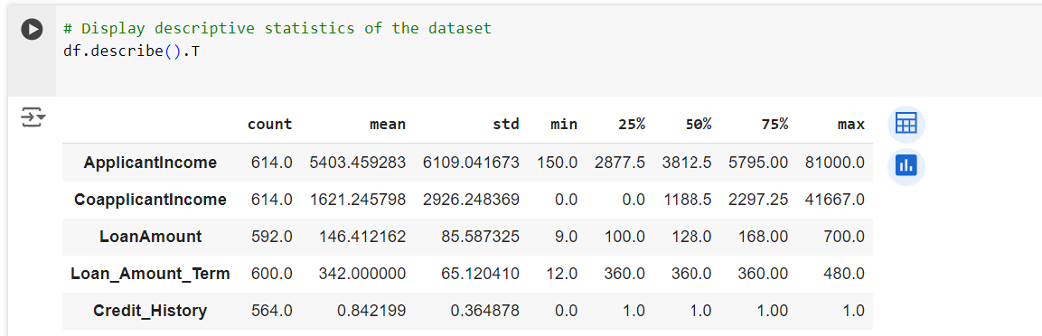
3. Exploratory Data Analysis ( EDA )
The EDA process involves examining the dataset to understand its structure, relationships, and patterns. Here are the key observations:
Dataset Structure: The dataset contains 614 entries and 13 features.
Data Types: The features include 8 categorical (object) and 5 numerical (float64 and int64) columns.
Non-null Counts: Some features have missing values, notably Gender, Married, Dependents, Self_Employed, LoanAmount, Loan_Amount_Term, and Credit_History.
Loan_ID: Unique identifier for each loan application.
Gender, Married, Dependents, Education, Self_Employed: Applicant demographics.
ApplicantIncome, CoapplicantIncome, LoanAmount, Loan_Amount_Term, Credit_History: Financial details.
Property_Area, Loan_Status: Loan status and property details.
These descriptive statistics highlight the diversity in applicant income and loan amounts, as well as the generally favorable credit histories of the applicants.

Slide 7
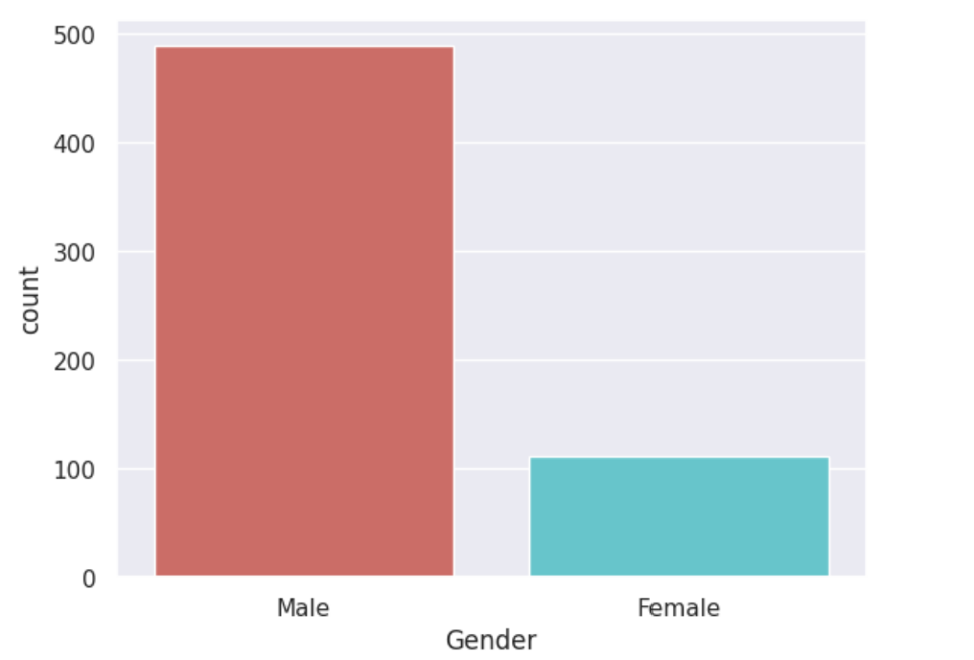
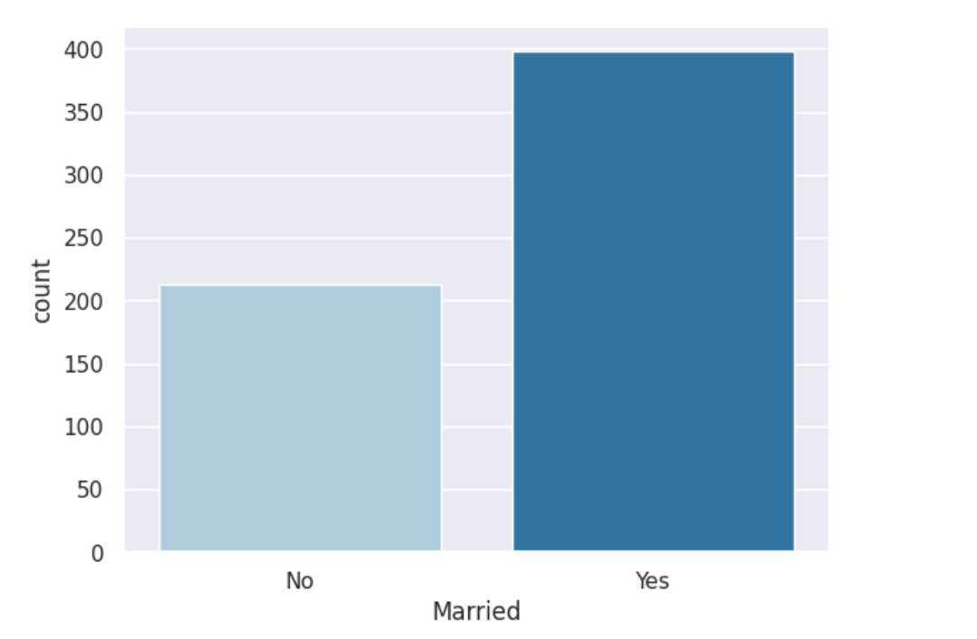
3. Exploratory Data Analysis ( EDA )
The dataset shows a significant imbalance in gender distribution, with a higher number of male applicants compared to female applicants.
A larger proportion of the loan applicants are married compared to those who are not married

Slide 8
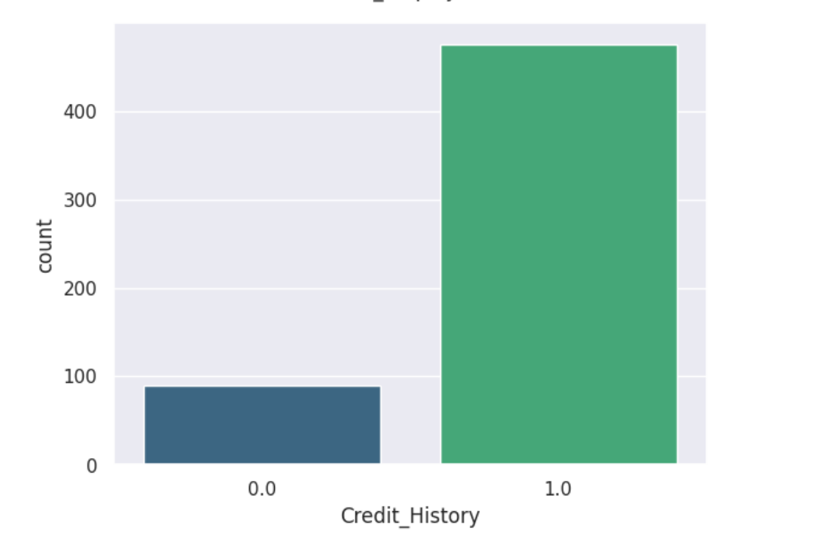
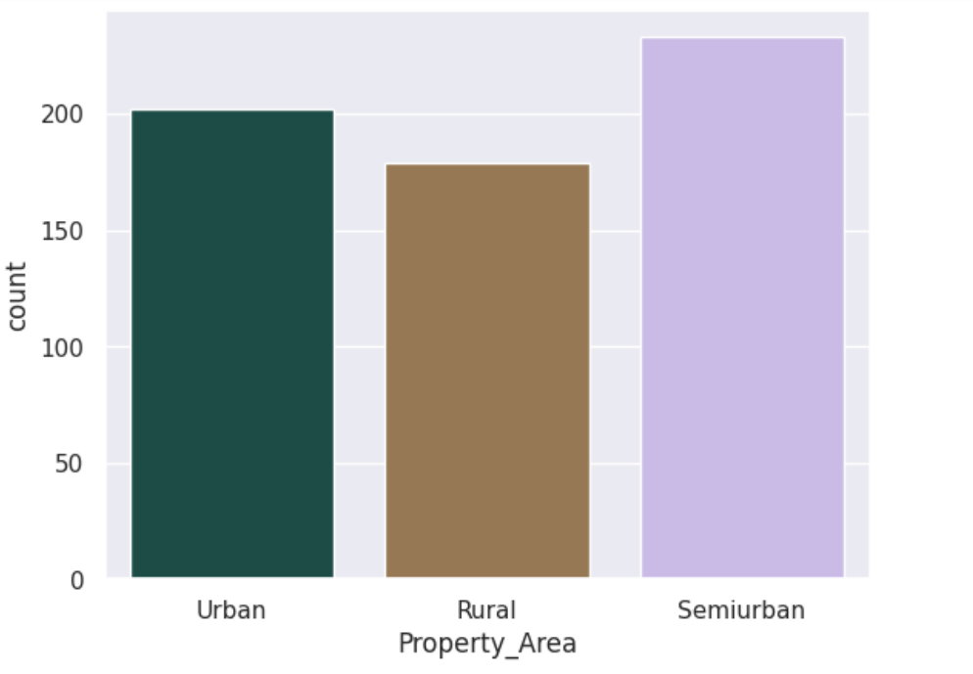
3. Exploratory Data Analysis ( EDA )
The majority of applicants have a good credit history (1.0), while a smaller proportion have a poor credit history (0.0).
Applicants are distributed across different property areas with a higher number from Semiurban areas, followed by Urban and Rural areas.

Slide 9
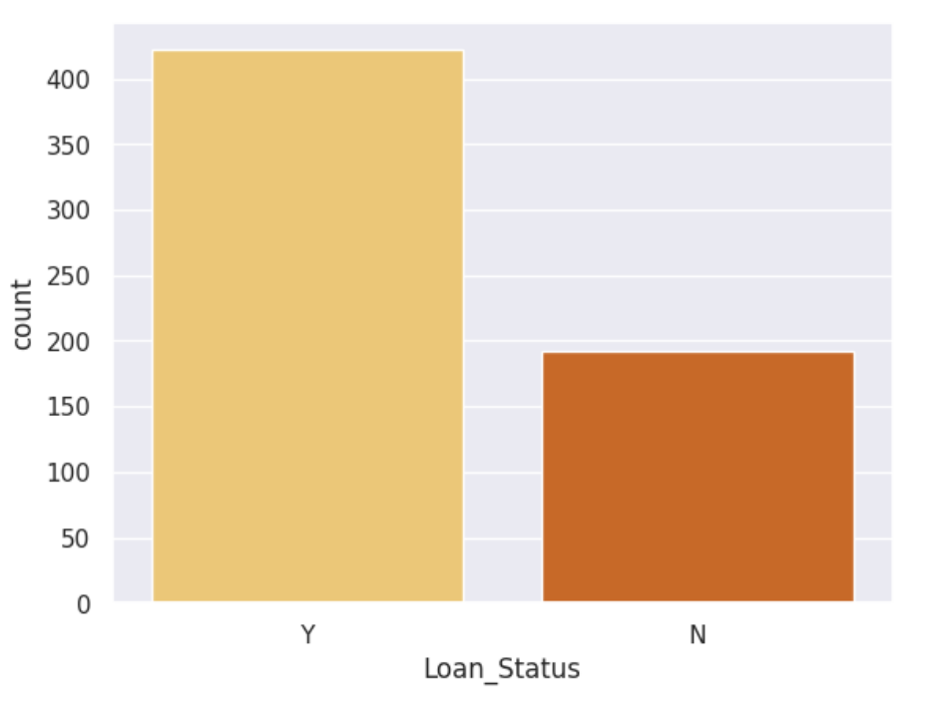
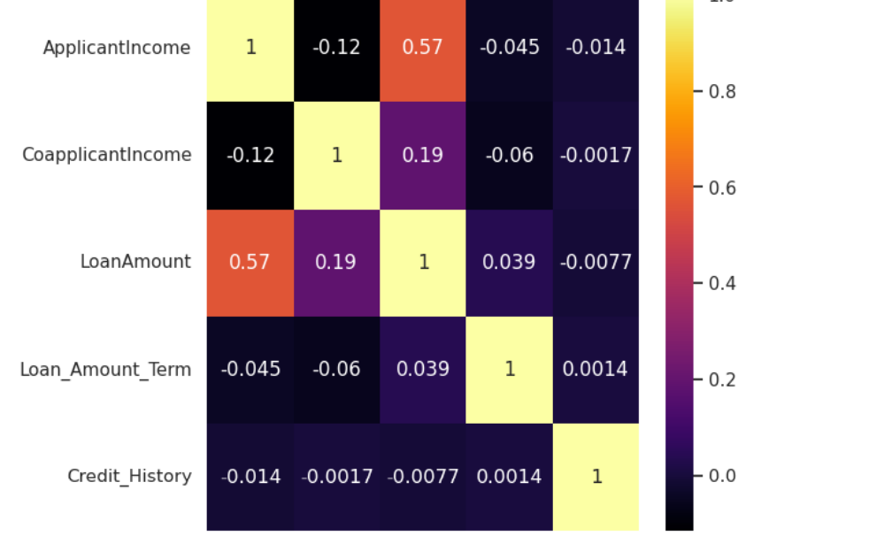
3. Exploratory Data Analysis ( EDA )
The majority of loan applications are approved (Y), while a smaller proportion are rejected (N).
Applicant income has the strongest correlation with loan amount, highlighting the importance of the applicant's income in determining the loan amount

Slide 10
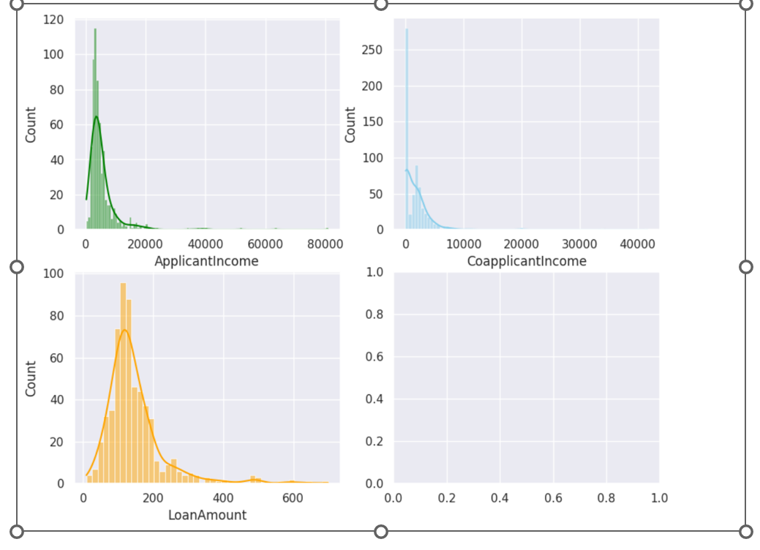
3. Exploratory Data Analysis ( EDA )
ApplicantIncome: The distribution is highly right-skewed, indicating that most applicants have lower incomes, with a few having significantly higher incomes.
CoapplicantIncome: Similarly, the coapplicant income is right-skewed, showing a concentration of lower-income values.
LoanAmount: The distribution of loan amounts is right-skewed as well, with most loans being on the lower side and a few high-value loans.
Skewness: The skewness in these distributions suggests the presence of outliers and indicates the need for data transformation to normalize the data.
Income Analysis: Understanding income distributions helps in assessing loan eligibility and potential risk.

Slide 11
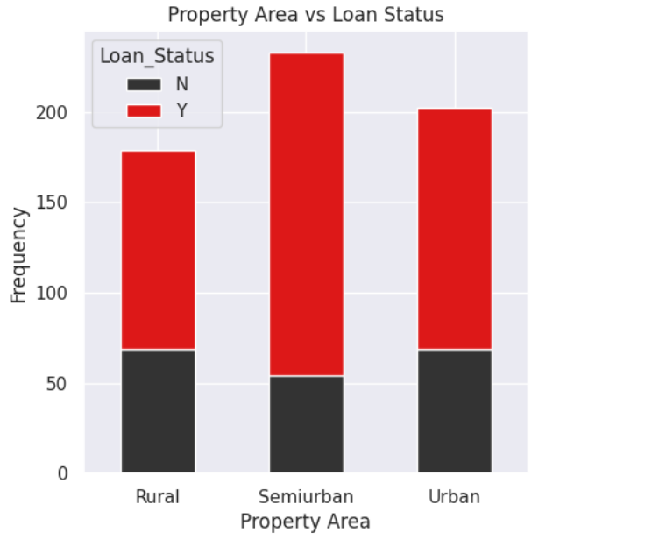
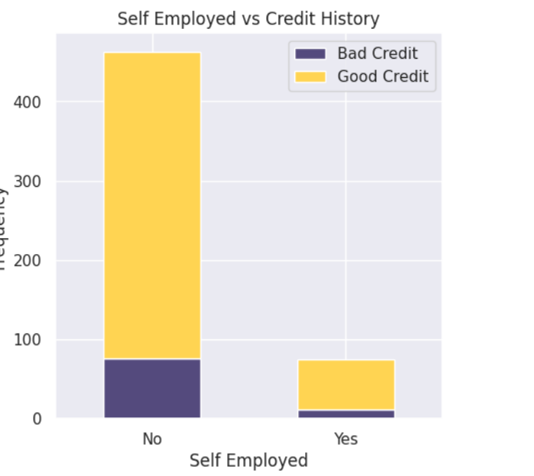
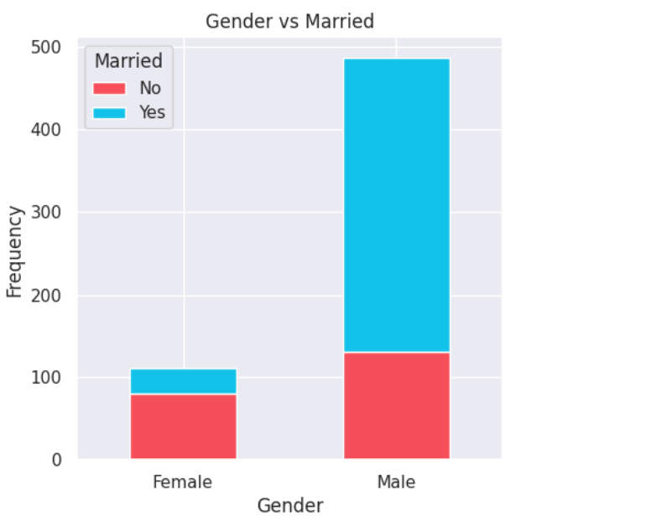
3. Exploratory Data Analysis ( EDA )
A higher number of male applicants compared to female applicants, with a majority of males being married.
Loan approval rates are higher in semiurban areas, followed by urban and rural areas.
Most applicants with good credit history are not self-employed.
A small number of self-employed applicants have good credit history.

Slide 12
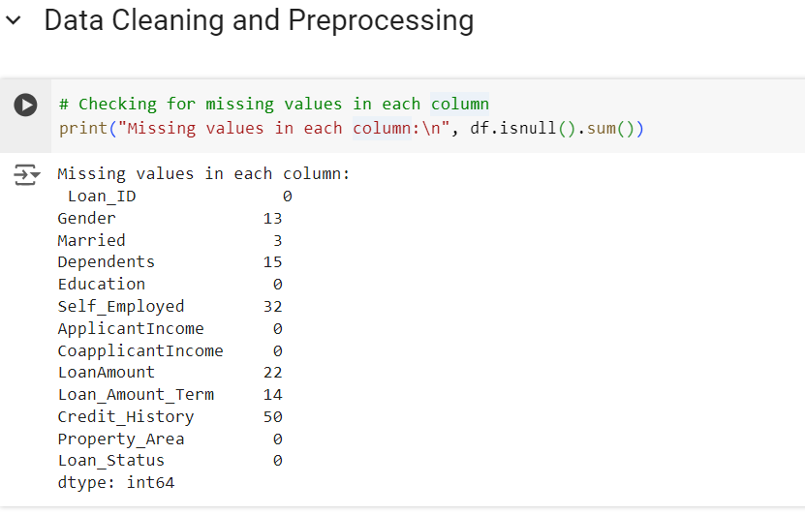
4. Data Cleaning and Preprocessing
Missing Values Check
Columns with missing values include Gender, Married, Dependents, Self_Employed, LoanAmount, Loan_Amount_Term, and Credit_History.
Handling Missing Values
Dropped the 'Loan_ID' column as it's not required for prediction.
Filled missing values with mode for categorical columns and mean for numerical columns.
Converted categorical variables to dummy/indicator variables to avoid multicollinearity and renamed columns for clarity.
Data Transformation:
Applied square root transformation to reduce skewness in ApplicantIncome, CoapplicantIncome, and LoanAmount.
Removed outliers using the IQR method.
Summary:
Improved data normalization and removed skewness to enhance model performance.
Ensured data quality by handling missing values and outliers effectively.

Slide 13
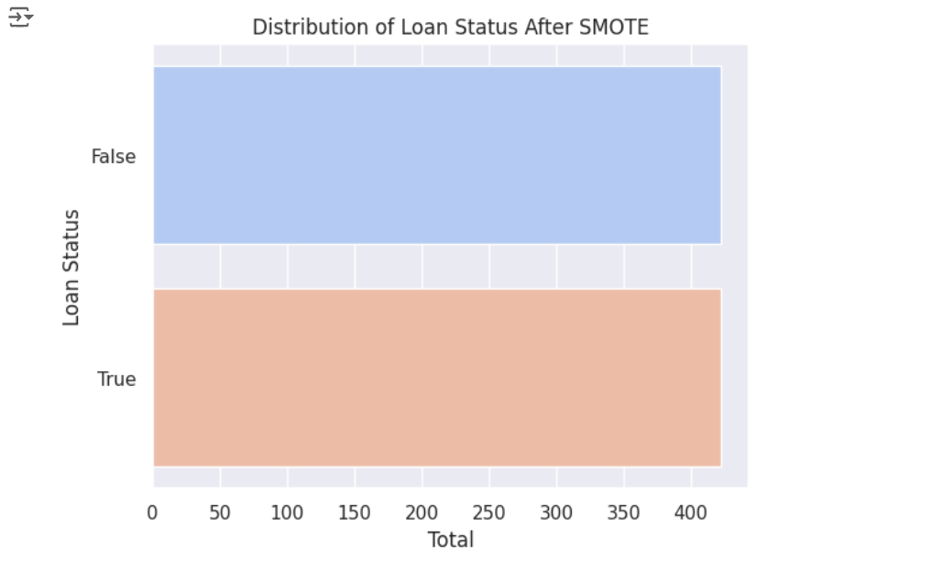
4. Data Cleaning and Preprocessing
Class Imbalance Handling with SMOTE
Addressed class imbalance using Synthetic Minority Over-sampling Technique (SMOTE) to balance the target variable (Loan Status).
The graph shows the distribution of Loan Status after applying SMOTE, with an equal number of instances for both classes (True and False)
Before SMOTE: Imbalanced dataset with fewer instances of one class, leading to biased model performance.
After SMOTE: Balanced dataset with equal representation of both classes, improving model robustness and accuracy.

Slide 14
5. Model Implementation
To predict loan repayment status, we implemented the following machine learning algorithms:
Logistic Regression: Chosen for its simplicity and interpretability, Logistic Regression serves as a strong baseline for comparison with more complex models. It is well-suited for binary classification tasks and provides insights into the relationships between features and the target variable.
K-Nearest Neighbors (KNN): This non-parametric algorithm classifies data points based on the majority class among its k-nearest neighbors. We chose KNN to explore the impact of local data structures and to understand the influence of neighborhood-based classification on loan repayment prediction.
Random Forest: An ensemble learning method that constructs multiple decision trees and combines their predictions. We selected Random Forest for its ability to handle diverse features, capture complex interactions, and reduce overfitting through ensemble averaging.

Slide 15
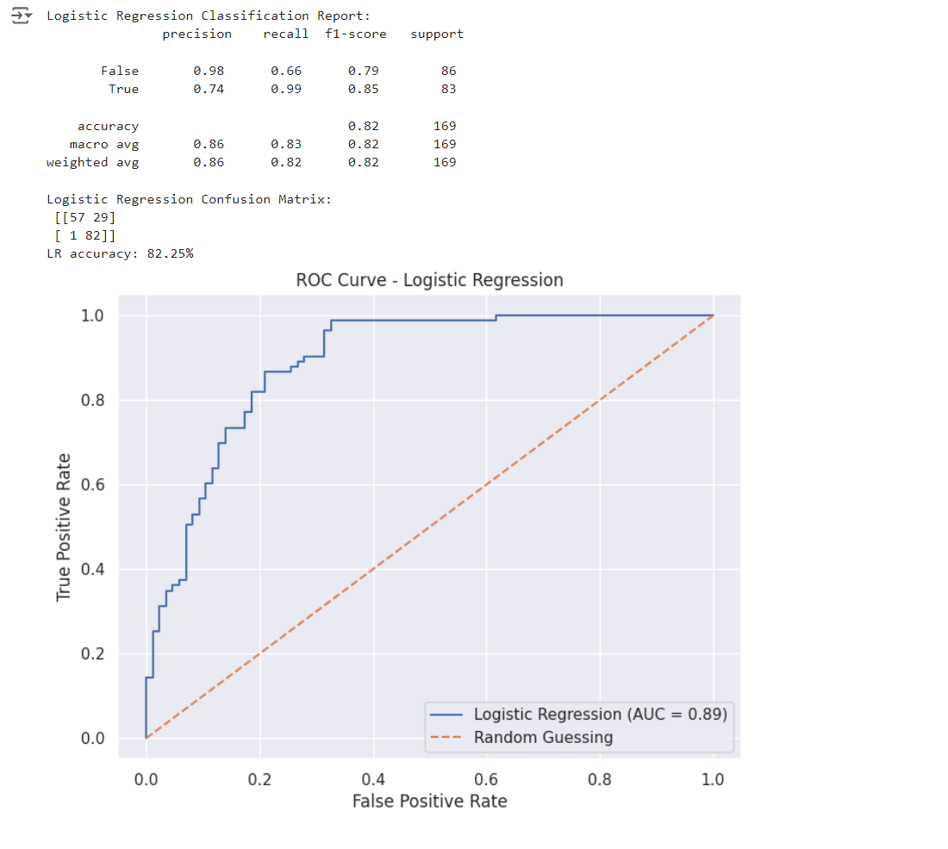
5.1. Logistic Regression
To predict loan repayment status effectively, we start with a Logistic Regression model. Logistic Regression is favored for its simplicity and interpretability, making it a suitable choice for binary classification tasks.
Our dataset, which includes features like applicant income, loan amount, and credit history, is ideal for this model.
The evaluation will focus on the model's accuracy, precision, and ROC AUC to ensure the reliability of our predictions.

Slide 16
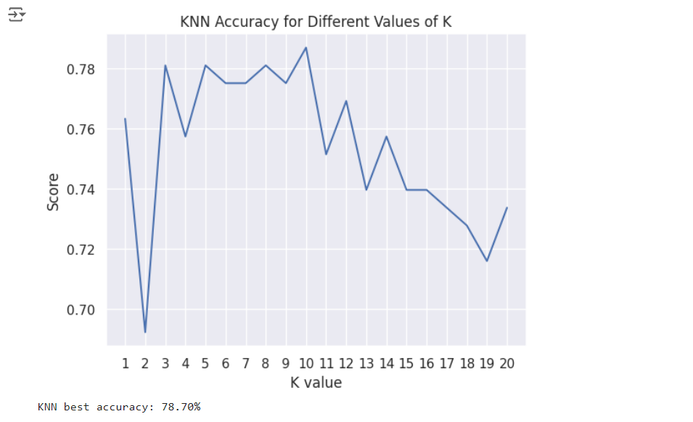
5.2. K Nearest Neighbours ( KNN)
We evaluate the K-Nearest Neighbors (KNN) model for predicting loan repayment status.
KNN classifies data points based on the majority class of its k-nearest neighbors. This model is suitable for our dataset, which includes features like applicant income, loan amount, and credit history.
We aim to determine the optimal number of neighbors (k) to maximize accuracy. KNN helps understand the local data structure and provides a comparative performance measure against our baseline Logistic Regression model.

Slide 17
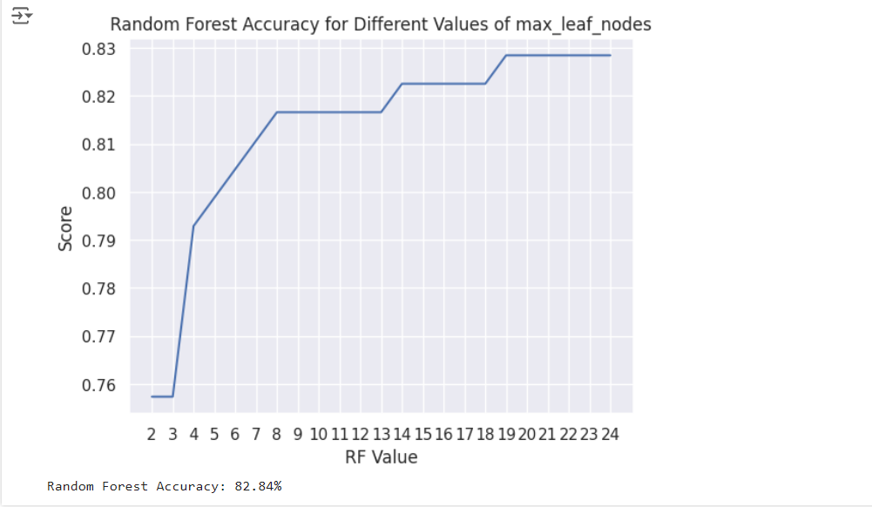
5.3. Random Forest
To predict loan repayment status, we next evaluate the Random Forest model. Random Forest is an ensemble learning method that builds multiple decision trees and combines their predictions to improve accuracy and reduce overfitting.
It handles diverse features, such as applicant income, loan amount, and credit history, capturing complex interactions.
We aim to optimize the Random Forest model's performance by tuning hyperparameters, providing a robust benchmark against simpler models like Logistic Regression and KNN.

Slide 18

6. Model Evaluation & Performance
Logistic Regression
Logistic Regression achieved an accuracy of 82.25% and a precision of 86.29%.
It serves as a strong baseline model with high precision, particularly in predicting non-repaid loans, but has a moderate number of false positives.
K-Nearest Neighbors (KNN)
K-Nearest Neighbors (KNN) achieved an accuracy of 78.70% and a precision of 81.67%.
While it is a simple and intuitive model, its performance is lower than that of Logistic Regression and Random Forest. The accuracy and precision of KNN are significantly influenced by the choice of k.
Random Forest
Random Forest achieved the highest accuracy of 82.84% and a precision of 86.64%.
This model benefits from tuning the max_leaf_nodes parameter and effectively captures complex interactions between features, making it the most effective model for loan repayment prediction in this evaluation.

Slide 19
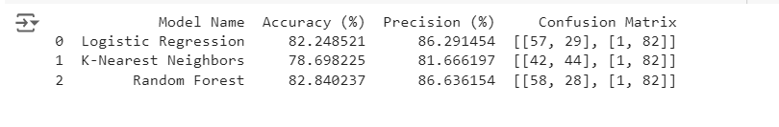
6. Model Evaluation & Performance
The Random Forest model emerged as the best model for loan repayment prediction, offering the highest accuracy and precision among the evaluated models.
Logistic Regression provides a strong baseline with reliable performance, and K-Nearest Neighbors (KNN) offers simplicity, though with slightly lower accuracy.
Further tuning and the exploration of more advanced models could potentially enhance the performance beyond these results, leading to even more accurate and robust predictions.

Slide 20
7. Conclusion
The Random Forest model consistently outperformed Logistic Regression and K-Nearest Neighbors, making it the most effective model for predicting loan repayment status.
It achieved the highest accuracy (82.84%) and precision (86.64%) in direct test set evaluation and maintained strong performance in cross-validation with an accuracy of 84.72% and precision of 85.67%.
Logistic Regression also demonstrated strong performance, serving as a robust baseline model. K-Nearest Neighbors, while easy to implement, showed lower performance.
The exploration of different modeling techniques has provided valuable insights, highlighting the importance of choosing the right model for the dataset's specific nuances

Slide 21
8. Limitations
Imbalanced Data: The initial imbalance in loan status could bias the model, even after applying techniques like SMOTE.
Missing Values: Handling missing data by filling with mean or mode might not capture the true underlying patterns.
Feature Selection: Some features may not have been fully optimized or engineered for the best predictive power.
Model Complexity: Simpler models like Logistic Regression and KNN might not capture complex interactions between features as effectively as more advanced models.
Overfitting Risk: Tuning parameters such as max_leaf_nodes in Random Forest needs careful balancing to avoid overfitting.

Slide 22

9. Future Scope
Hyperparameter Tuning: Further optimize model performance by exploring a wider range of hyperparameters using grid search or random search.
Feature Engineering: Create new features or transform existing ones to capture more information and improve model accuracy.
Ensemble Methods: Combine multiple models, such as boosting or stacking, to leverage the strengths of different algorithms.
Advanced Algorithms: Explore sophisticated algorithms like Gradient Boosting, XGBoost, or deep learning models for potentially better performance.
Real-Time Prediction: Implement the model in a real-time system to provide immediate loan repayment predictions and assist decision-making processes for financial institutions.

